Slide 1
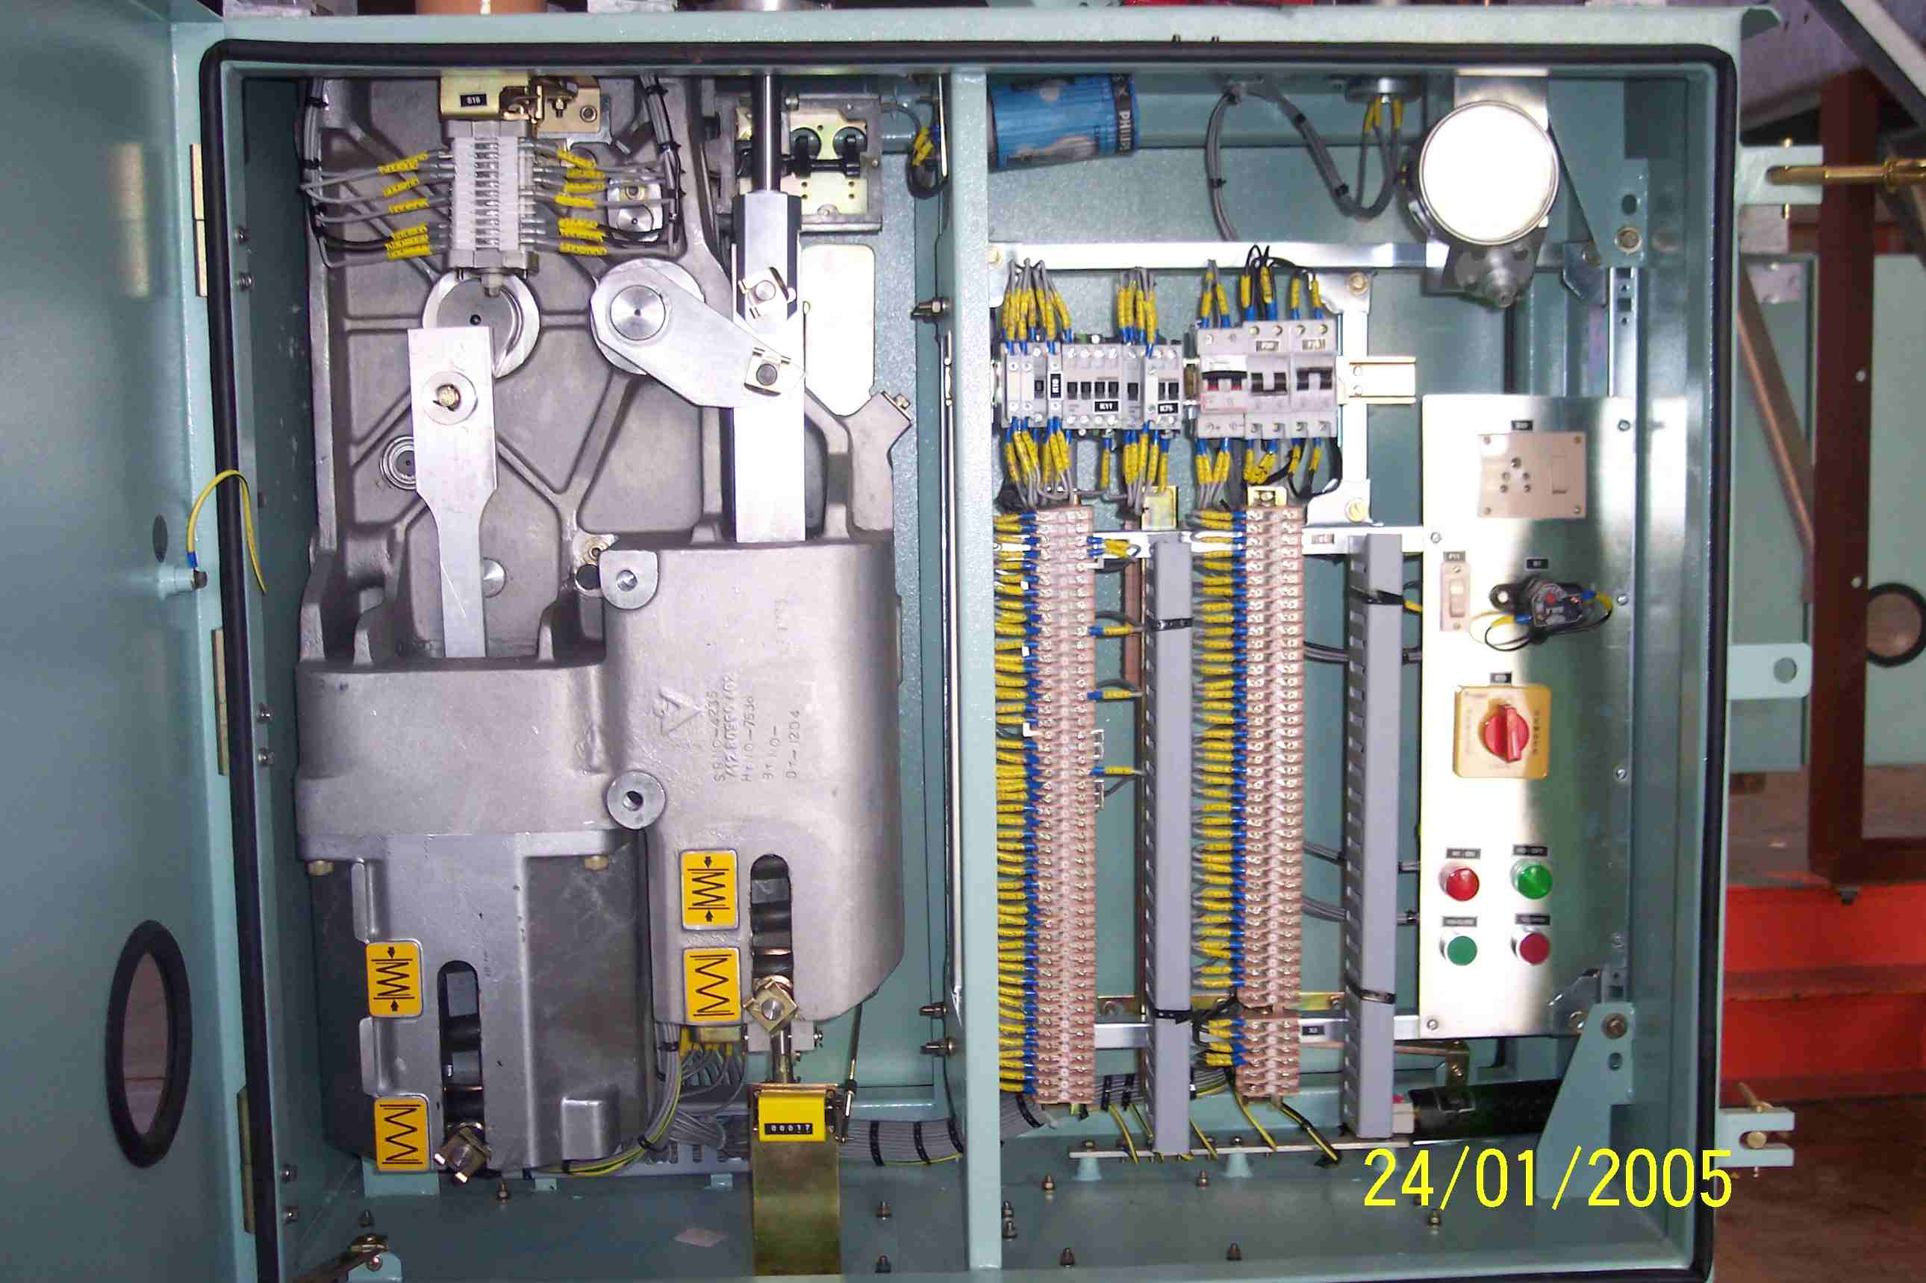
SIEMENS
HVCB SPARES
Gasket for Operating Mechanism Cubicle
72.5KV, 145KV & 245KV CB
S4799247001

